Slide 1

"GROWING
TOGETHER"
Presented by TEAM SLAYERS

Slide 2

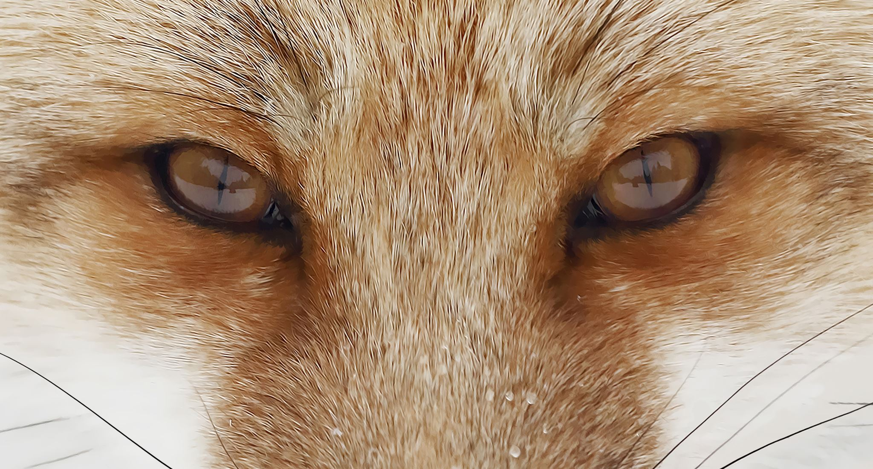

MOTIVE
To let you freely enjoy your trips without worring about your pets WE ARE HERE WHEN YOU CAN'T BE....
Taking an initiative to start a PET SITTING business follwed up by SPCEIAL NGO FOR STREET DOGS and DISOWNED DOGS.

Slide 3

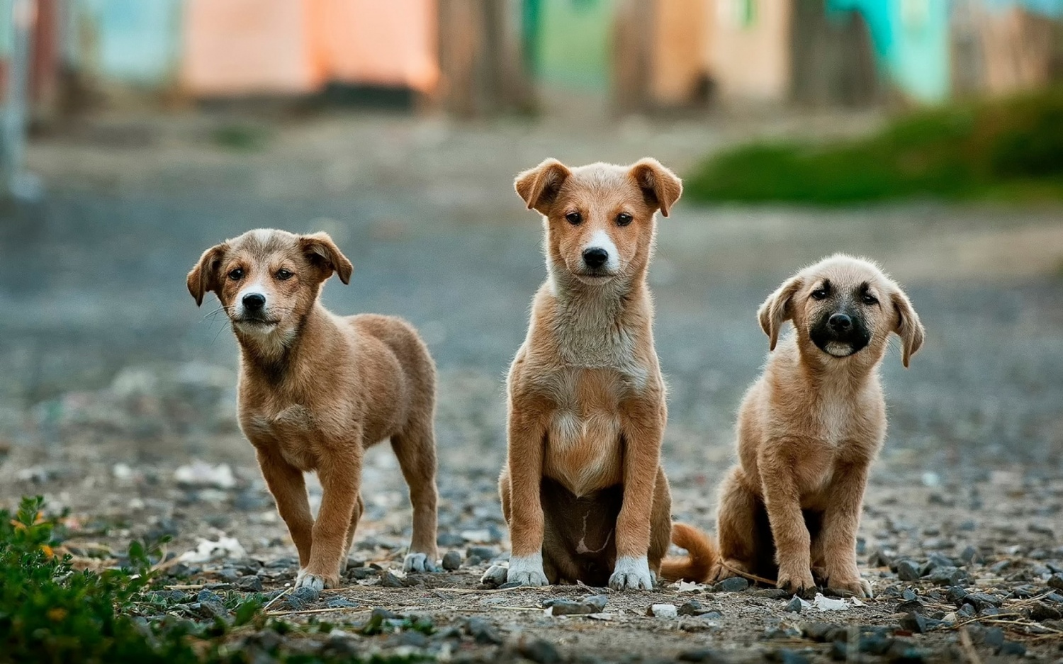
PET SITTING AND NGO FOR STREET DOGS STARTUP
A PRESENTATION TO PROVIDE NEW SURROUNDINGS AND SHELTERS TO THEM .WE BELIEVE THAT EVERY DOG DESERVES A LOVING HOME AND A BRIGHT FUTURE....
Lets work on "GROWING TOGETHER TO GET BETTER"

Slide 4
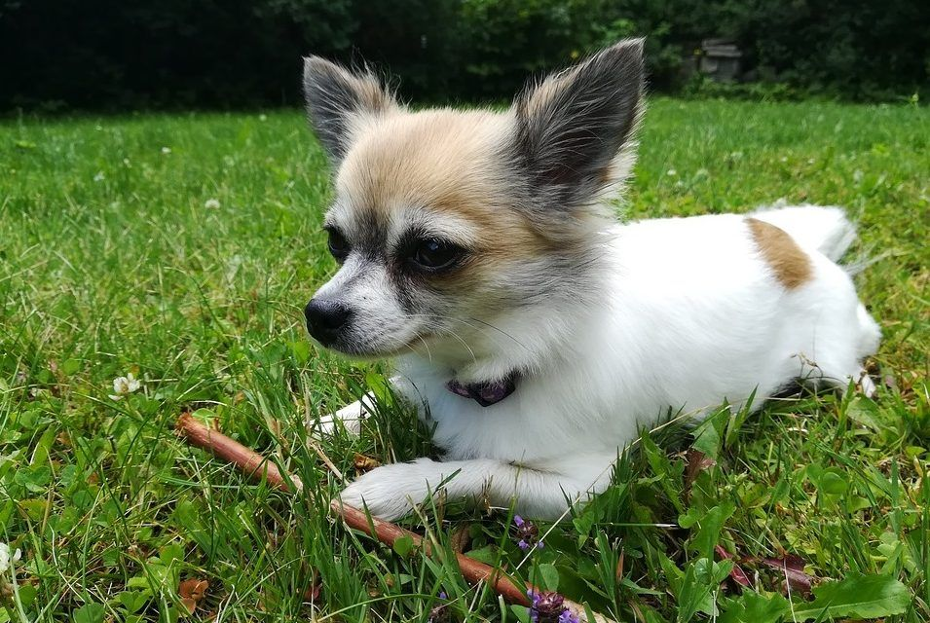

PET SITTING
FROM THE SHELTER

Slide 5

PROBLEMS FACED BY PET OWNERS....
Pets not allowed at
Museums
Hospitals
Most of tourist places

Slide 6
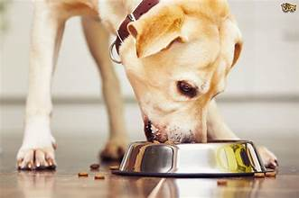
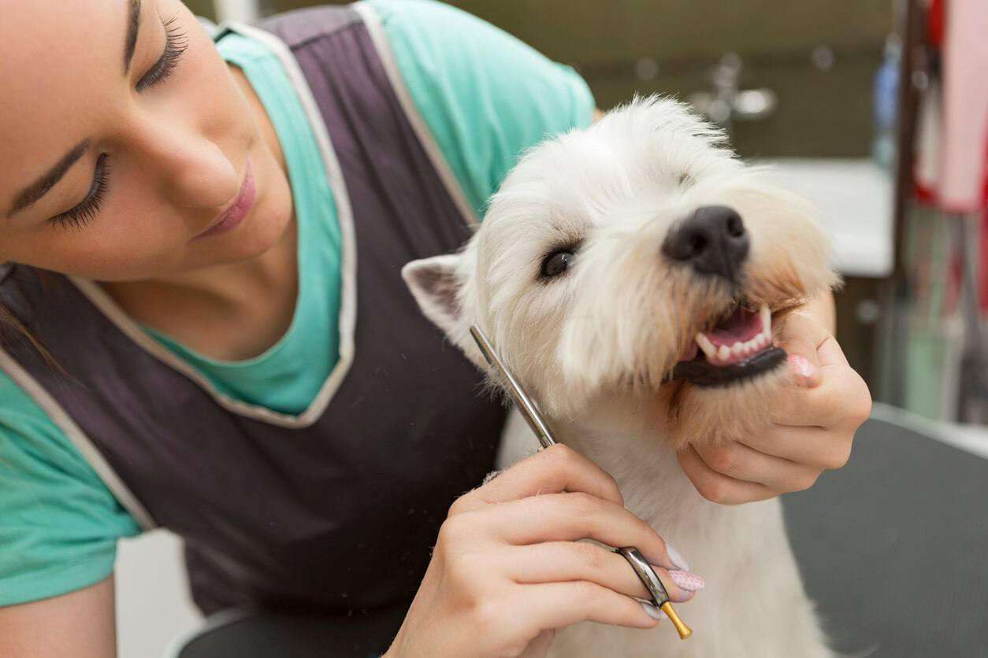

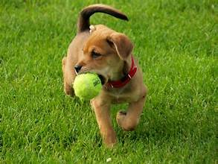
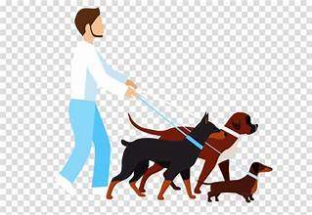
WE OFFER
Dog feeding
Grooming
Door step pick up and drop up
Certified walkers
Play times

Slide 7
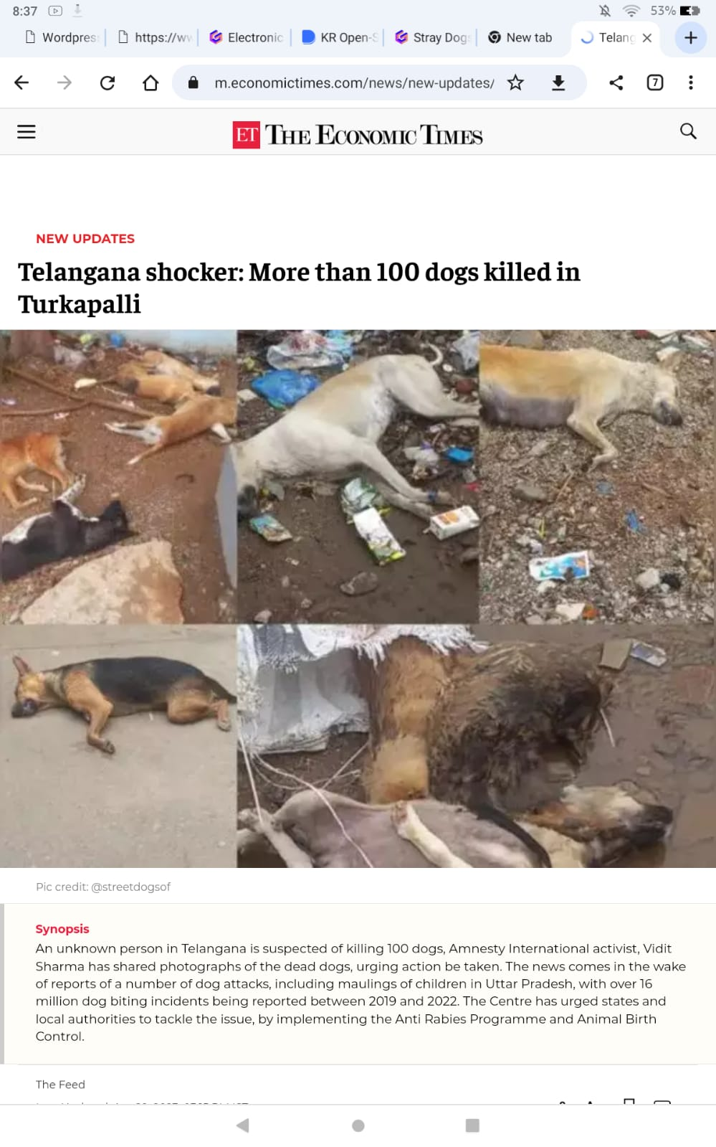

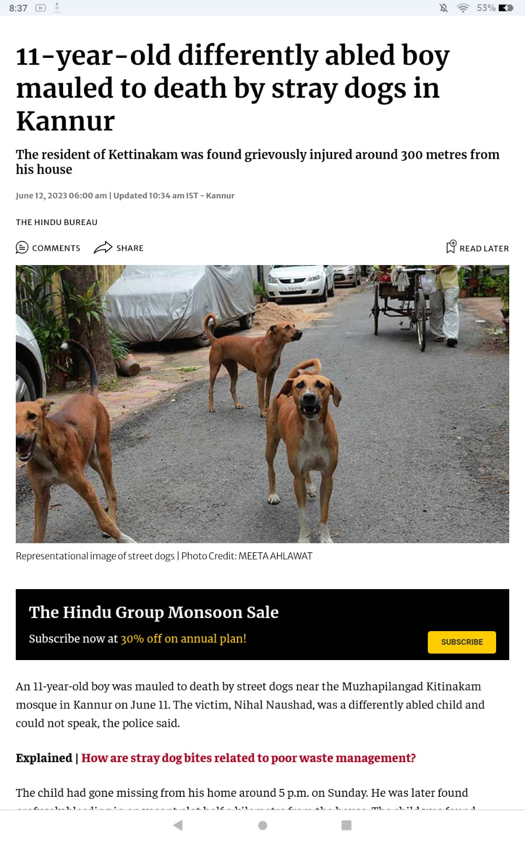
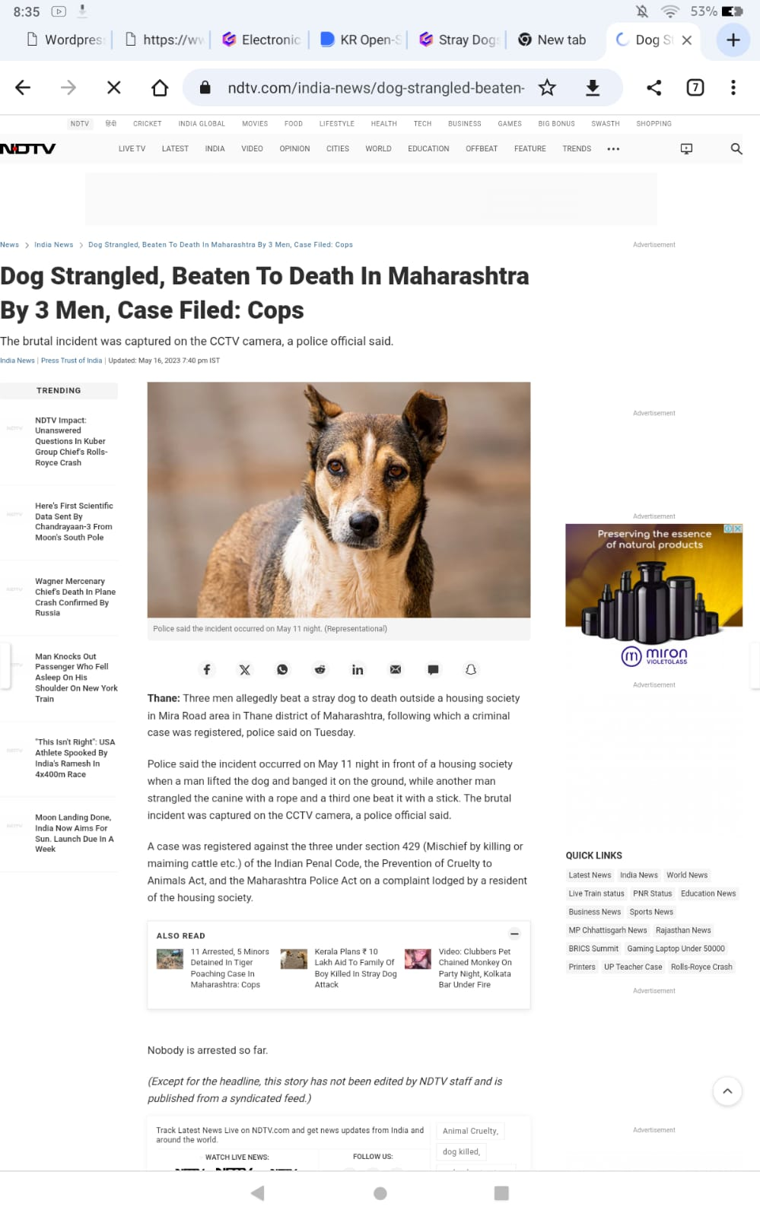
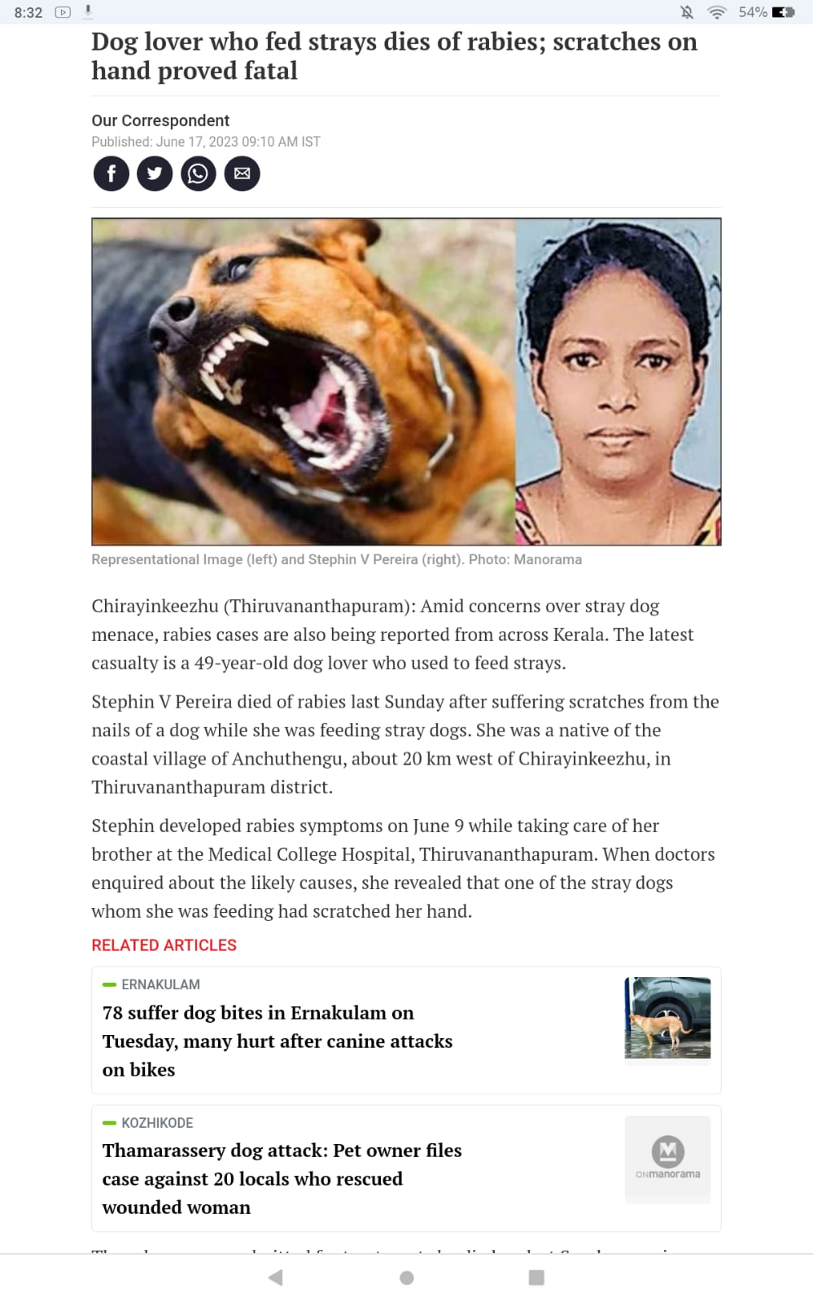
Lets go through these....

Slide 8

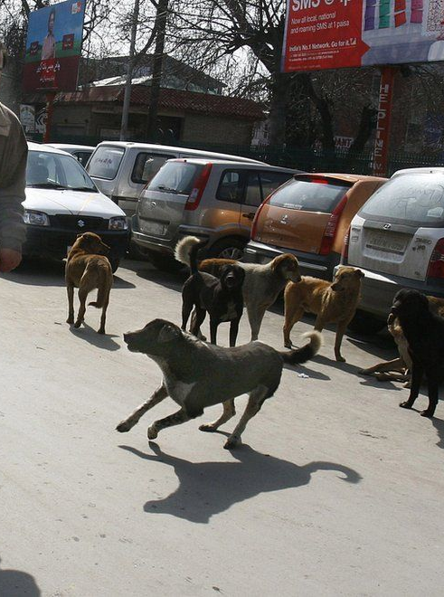
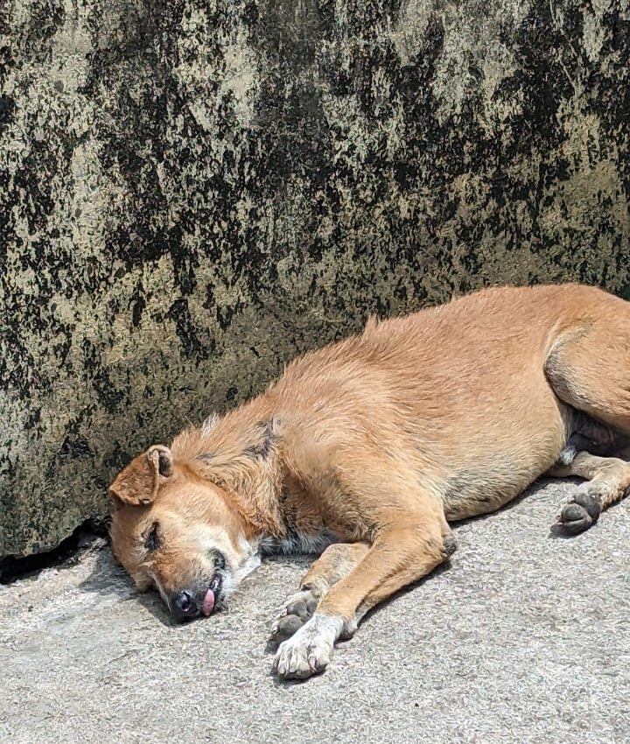
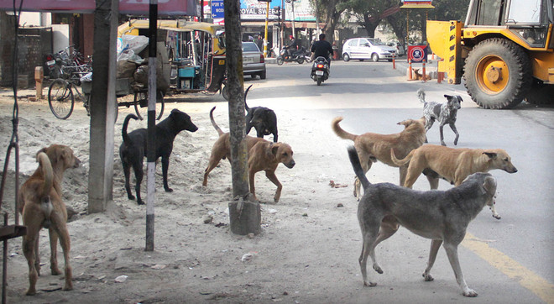
CHALLENGES FACED BY STRAY DOGS
LACK OF MEDICAL CARE
Stray dogs are prone to diseases as they are not provided with medical care.
AGGRESSIVE BEHAVIOUR
Being abondoned and fending themselves can make them aggressive towards humans and they may start attacking.
IMPACT ON SOCIETY
Stray dogs cause chaos on the streets which can result in road accidents.

Slide 9
OUR INITIATIVE
Medical care
Shelter
Training
Healthy environment
EDUCATIONAL PROGRAMMES : Educating people about responsible dog ownership and neutering pets.
New Homes : through ADOPTION CAMPAIGNS

Slide 10

DO YOU KNOW ?
To make it from home ...we are developing an idea for an app so that you can adopt a new pet by just sitting on your sofa and get a special code and all the details of your new member .
With the help of the app you can also trace your pet.
Your will also get to know how to feed ,what to feed your pet by just sitting at your home.

Slide 11




Fundraising goals and strategy
FUND RAISING EVENTS
ONLINE DONATIONS
SPONSORSHIPS
PROMOTIONS THROUGH SOCIAL MEDIA
OTHER FUNDING INITIATIVES: LOANS,PROMOTIONS THROUGH FAMILY AND FREINDS

Slide 12


OUR PLANS TO START SHOWERING LOVE
FROM OUR PLACE ITSELF....

Slide 13
THANKYOU

